Slide 1
What is OS patching?
OS patching is the practice of applying software patches to the operating systems installed in your environment to ensure they remain safe, secure, and protected from external threats.
Patches are software and operating system (OS) updates that address security vulnerabilities within a program or product. Software vendors may choose to release updates to fix performance bugs, as well as to provide enhanced security features.

Slide 2
What are Windows OS patches?
A patch is a software update released to correct errors, bugs, or security vulnerabilities in computer programs. Microsoft releases patches to fix vulnerabilities in their software on a regular basis. Patches are usually released as an update that can be downloaded and installed to update an application or system.

Slide 3
How does Windows patching work?
Windows Update downloads manifest files and provides them to the arbiter. The arbiter evaluates the manifest and tells the Windows Update client to download files. Windows Update client downloads files in a temporary folder. The arbiter stages the downloaded files.
Notes:
arbiter
a person who settles a dispute or has ultimate authority in a matter.
Windows Update Arbiter handle- Code that is included in the UpdateAgent binary. The arbiter gathers information about the device, and uses the CompDB(s) to output an action list.

Slide 4
Is patching the same as updating?
While general software updates can include lots of different features, patches are updates that address specific vulnerabilities. Vulnerabilities are “holes” or weaknesses in the security of a software program or operating system.

Slide 5

What happens if patching is not done?
Lack of regular patching means the existing ones will go out of date, leaving them vulnerable to cyber threats. Once companies are known to be vulnerable at specific endpoints, the perfect malware is introduced by hackers to exploit the weakness.

Slide 6
What are the three types of patching?
The three most common types of patches are security patches, bug fixes, and feature updates.
Why is OS patching required?
Security: A common cause of network security breaches is missing patches in operating systems. Having a regular patch schedule means installing updates promptly, reducing the opportunity for data loss and damage to your infrastructure.
New features: Patches are not always about protection from malware or fixing bugs.

Slide 7
Types of Windows Patches
What are some types of Windows patches? These can be classified into several categories as seen below:
Critical Updates
Security Updates
Microsoft Quality Updates
Updates
Update Rollups
Definition Updates
Feature Packs
Drivers
Tools

Slide 8
How do I manually update Windows patches?
If you want to install the update now, select Start > Settings > Update & Security > Windows Update , and then select Check for updates. If updates are available, install them.

Slide 9
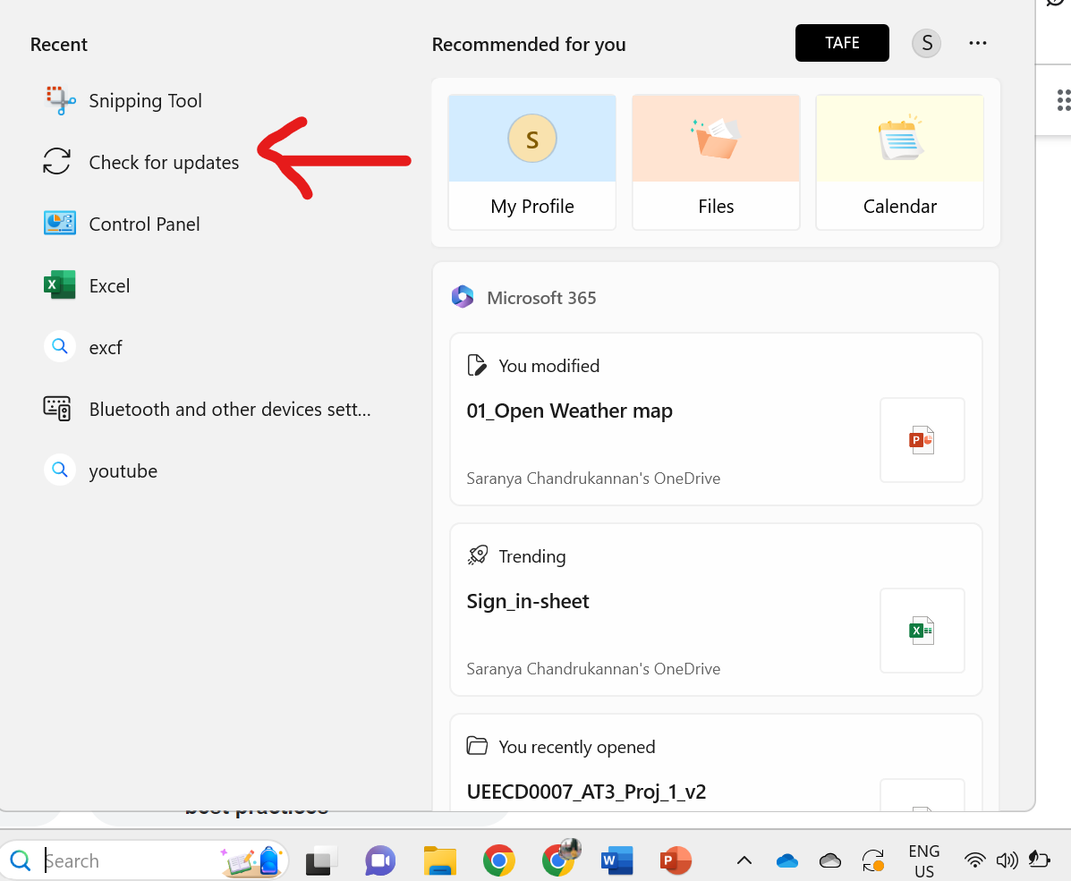

Slide 10
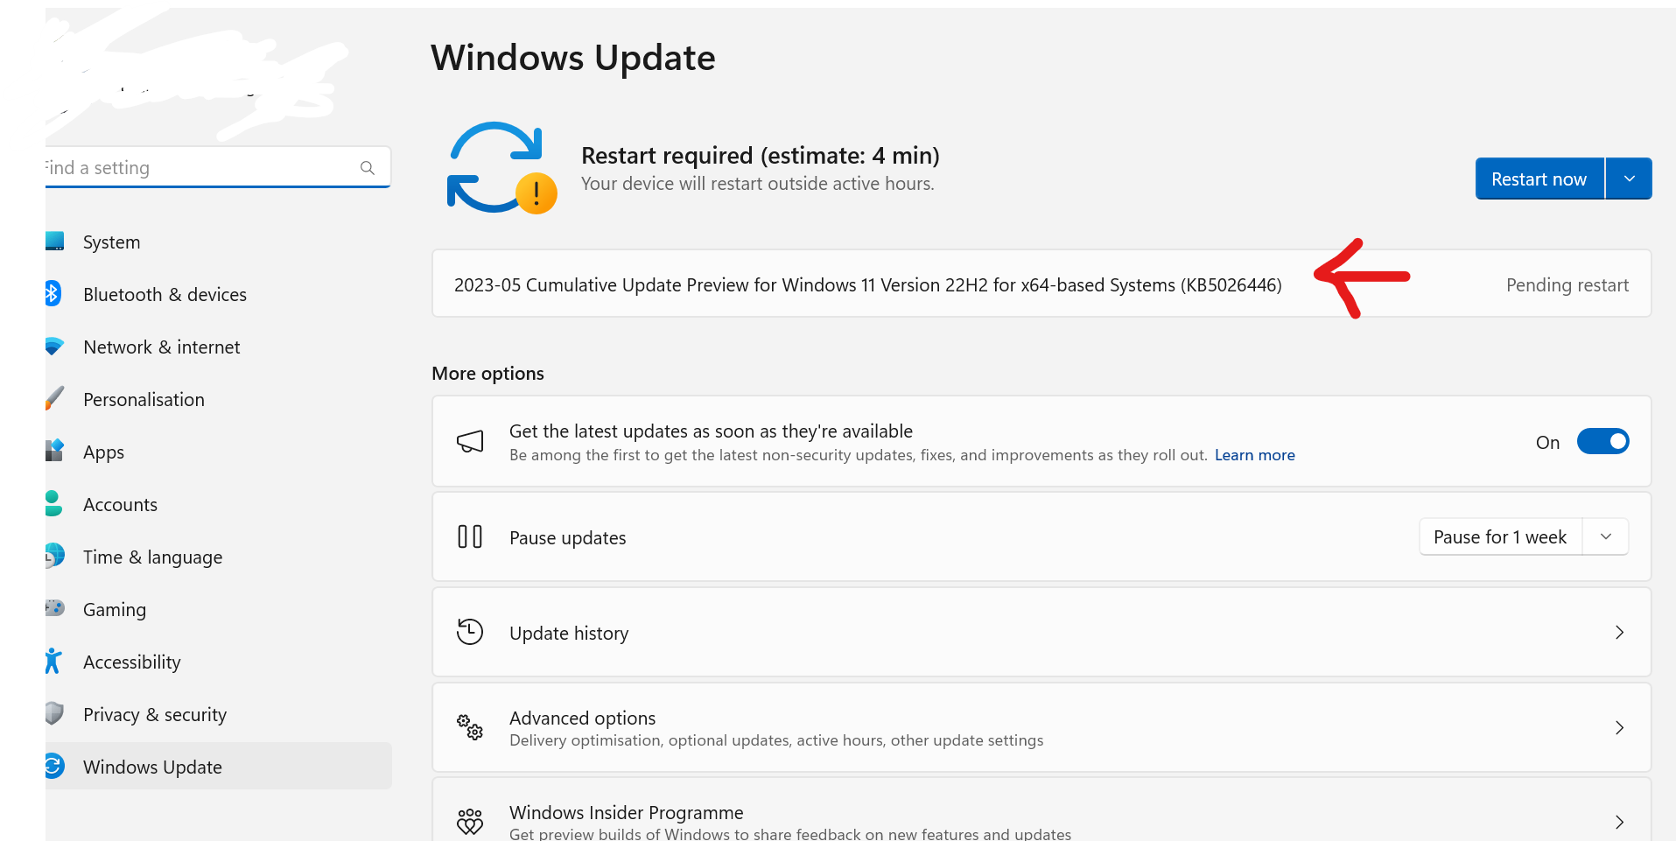

Slide 11
